Slide 1
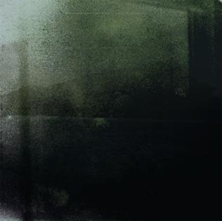
Gamma Knife
Notes:
Kayo Dot is the artist

Slide 2
What is it?
Co-60 sources
~30 Ci each
Collimator focused
Notes:
56.9k treated in 2010

Slide 3
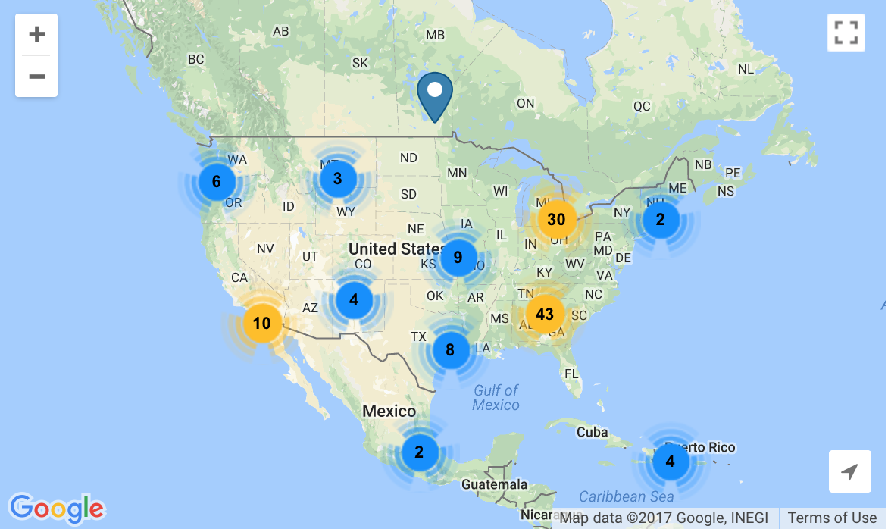
History
Developed by Lars Leksell in Stockholm
Treat small tumors in brain
Useful in other cases (AVM)
Notes:
Trigeminal neuralgia is a chronic pain condition that causes intense pain from any stimulation of the face
arterio-venous malformation

Slide 4
Comparison with LINAC
LINAC
Gamma Knife
Larger treatment volumes
Repairs/servicing required more often
Estimated life around 10 years
Smaller treatment volumes
Higher acquisition costs
Lower operating costs
20 year service life
Replace sources 5-7 years
Notes:
More precise
http://gammaknife.com/what-is-gamma-knife/

Slide 5
More comparison
LINAC
Gamma Knife
Fractionated doses
More dose leakage
Source/beam moves
Brain only!
Single-day treatment
Notes:
2-3 times more dose to the healthy brain with LINAC
http://gammaknife.com/what-is-gamma-knife/

Slide 6
Advantages!
Out of 835 treated:
2.2% had neurological event or death
5/835 had temporary neurological deficits
SRS alone as “effective” as WBRT+SRS
Higher relapse rate
Notes:
Chin, L. S., Lazio, B. E., Biggins, T., & Amin, P. (2000). Acute complications following gamma knife radiosurgery are rare. Surgical Neurology, 53(5), 498–502. https://doi.org/10.1016/S0090-3019(00)00219-6
Study looked at complications within 7 days after surgery

Slide 7
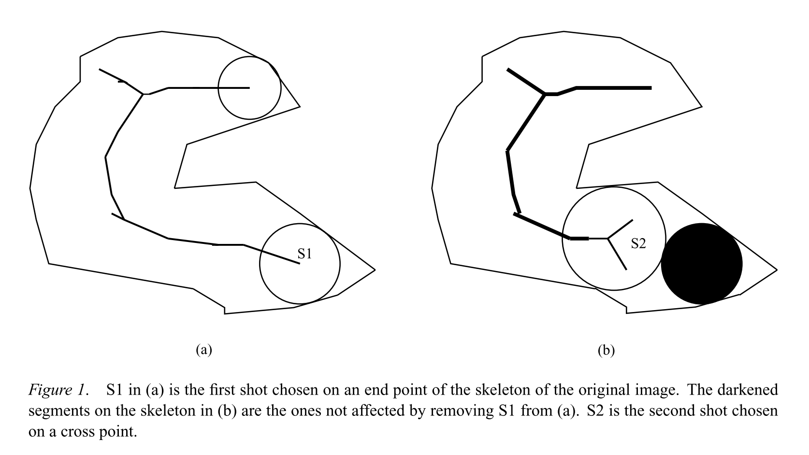
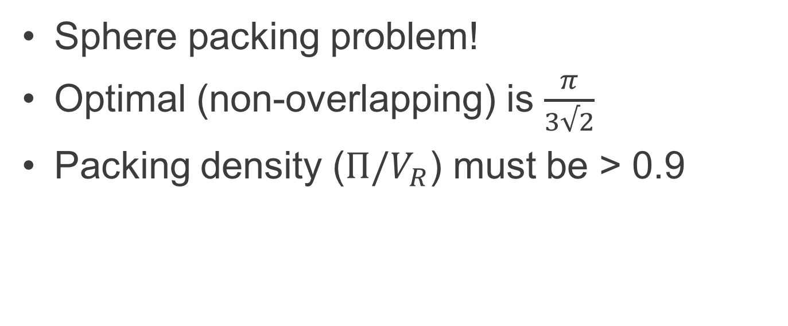
Surgery planning
Sphere packing problem!
Optimal (non-overlapping) is $\frac{π}{3√2}$
Packing density ($Π/V_{R}$) must be > 0.9
Notes:
Non-overlapping packing doesn’t apply, plus we want to minimize number of spheres
Wang, J. (1999). Packing of Unequal Spheres and Automated Radiosurgical Treatment Planning. Journal of Combinatorial Optimization, 3(4), 453–463. https://doi.org/10.1023/A:1009831621621
Bourland, J. D., & Wu, Q. R. (1996). Use of shape for automated, optimized 3D radiosurgical treatment planning (pp. 553–558). Springer, Berlin, Heidelberg. https://doi.org/10.1007/BFb0046998

Slide 8
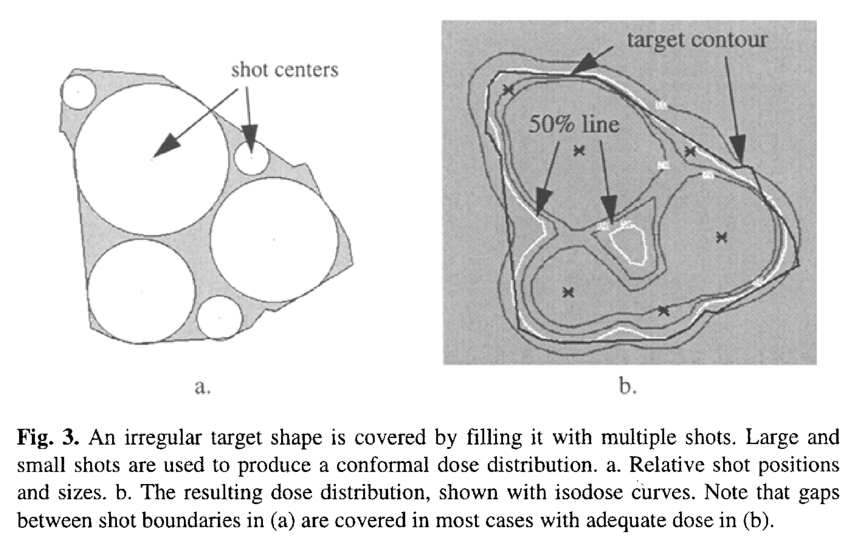
Sphere packing
Notes:
Bourland, J. D., & Wu, Q. R. (1996). Use of shape for automated, optimized 3D radiosurgical treatment planning (pp. 553–558). Springer, Berlin, Heidelberg. https://doi.org/10.1007/BFb0046998

Slide 9
Treatment
pituitary adenomas
schwannoma
vascular malformations
menigioma
melanoma
glioma

Slide 10
Vascular Malformations
Comparable treatments
Lower dose from LINAC (16 vs 20 Gy)
Equivalent effectiveness (72% vs 60% success, but not statistically significant)
Notes:
Alternatives
Surgical excision
Endovascular coiling (make a clot)
Endovascular embolization (create a clot)

Slide 11
Neural disorder treatment
Trigeminal Neuralgia 10-year follow up study: bothersome in <2% of patients
Epilepsy seizure cessation in epilepsy patients treated for AVT, biochemical changes in rats
OCD ~50% of patients responded to gamma knife capsulotomy
Notes:
The cells don’t die though!

Slide 12
Trigeminal Neuralgia
Notes:
Treatment effectiveness from 75 Gy GKS vs time. One third of these patients had already had 1-3 physical surgeries. Response duration was better if you had never had physical surgery. Other experiment showed 26/52 patients experienced pain relief (not TN)
Found 2 studies confirming
Dhople, A. A., Adams, J. R., Maggio, W. W., Naqvi, S. A., Regine, W. F., & Kwok, Y. (2009). Long-term outcomes of Gamma Knife radiosurgery for classic trigeminal neuralgia: implications of treatment and critical review of the literature. Journal of Neurosurgery, 111(2), 351–358. https://doi.org/10.3171/2009.2.JNS08977

Slide 13
Parkinson Disease
Japanese study
72 treated, 53 completed follow-up
43 evaluated as “excellent or good results”
Notes:
Same regions as deep brain stimulation
Ohye, C., Higuchi, Y., Shibazaki, T., Hashimoto, T., Koyama, T., Hirai, T., … Yamashiro, K. (2012). Gamma Knife Thalamotomy for Parkinson Disease and Essential Tremor. Neurosurgery, 70(3), 526–536. https://doi.org/10.1227/NEU.0b013e3182350893

Slide 14
Epilepsy
AVM patients with epilepsy noted having lower seizure rates post GK
Amygdalohippocampectomy
6/7 patients seizure-free at 61 months
Notes:
Régis, J., Bartolomei, F., Rey, M., Genton, P., Dravet, C., Semah, F., … Peragut, J.-C. C. (1999). Gamma knife surgery for mesial temporal lobe epilepsy. Epilepsia, 40(11), 1551–1556. https://doi.org/10.1111/j.0013-9580.2005.53904.x

Slide 15
Obsessive Compulsive Disorder
16 patients, half given gamma ventral capsulotomy
5/8 in experimental group responded to treatment at ~5 years
4 of control group got treatment later, 2/4 effective
~50% improve by 35% on Y-BOCS
Notes:
Capsule deep inside the “inner capsule” of the brain
Yale-Brown Obsessive Compulsive Scale
Lopes, A. C., Greenberg, B. D., Canteras, M. M., Batistuzzo, M. C., Hoexter, M. Q., Gentil, A. F., … Miguel, E. C. (2014). Gamma Ventral Capsulotomy for Obsessive-Compulsive Disorder. JAMA Psychiatry, 71(9), 1066. https://doi.org/10.1001/jamapsychiatry.2014.1193

Slide 16
Treatment area

Slide 17
Functional effects?
Experiment with rats
“Differential effects were first observed between glutamate decarboxylase and choline acetyltransferase, and secondarily between excitatory amino acids (AAs) and non-excitatory AAs, particularly gamma-aminobutyric acid.”
Notes:
glutamate decarboxylase – excitatory neuro transmitter
choline acetyltransferase – muscle transmitter
gamma-aminobutyric acid -
Régis, J., Kerkerian-Legoff, L., Rey, M., Vial, M., Porcheron, D., Nieoullon, A., & Peragut, J. C. (1996). First biochemical evidence of differential functional effects following Gamma Knife surgery. Stereotactic and Functional Neurosurgery, 66 Suppl 1, 29–38. Retrieved from http://www.ncbi.nlm.nih.gov/pubmed/9032842

Slide 18
References

Slide 19
Questions

